Slide 1
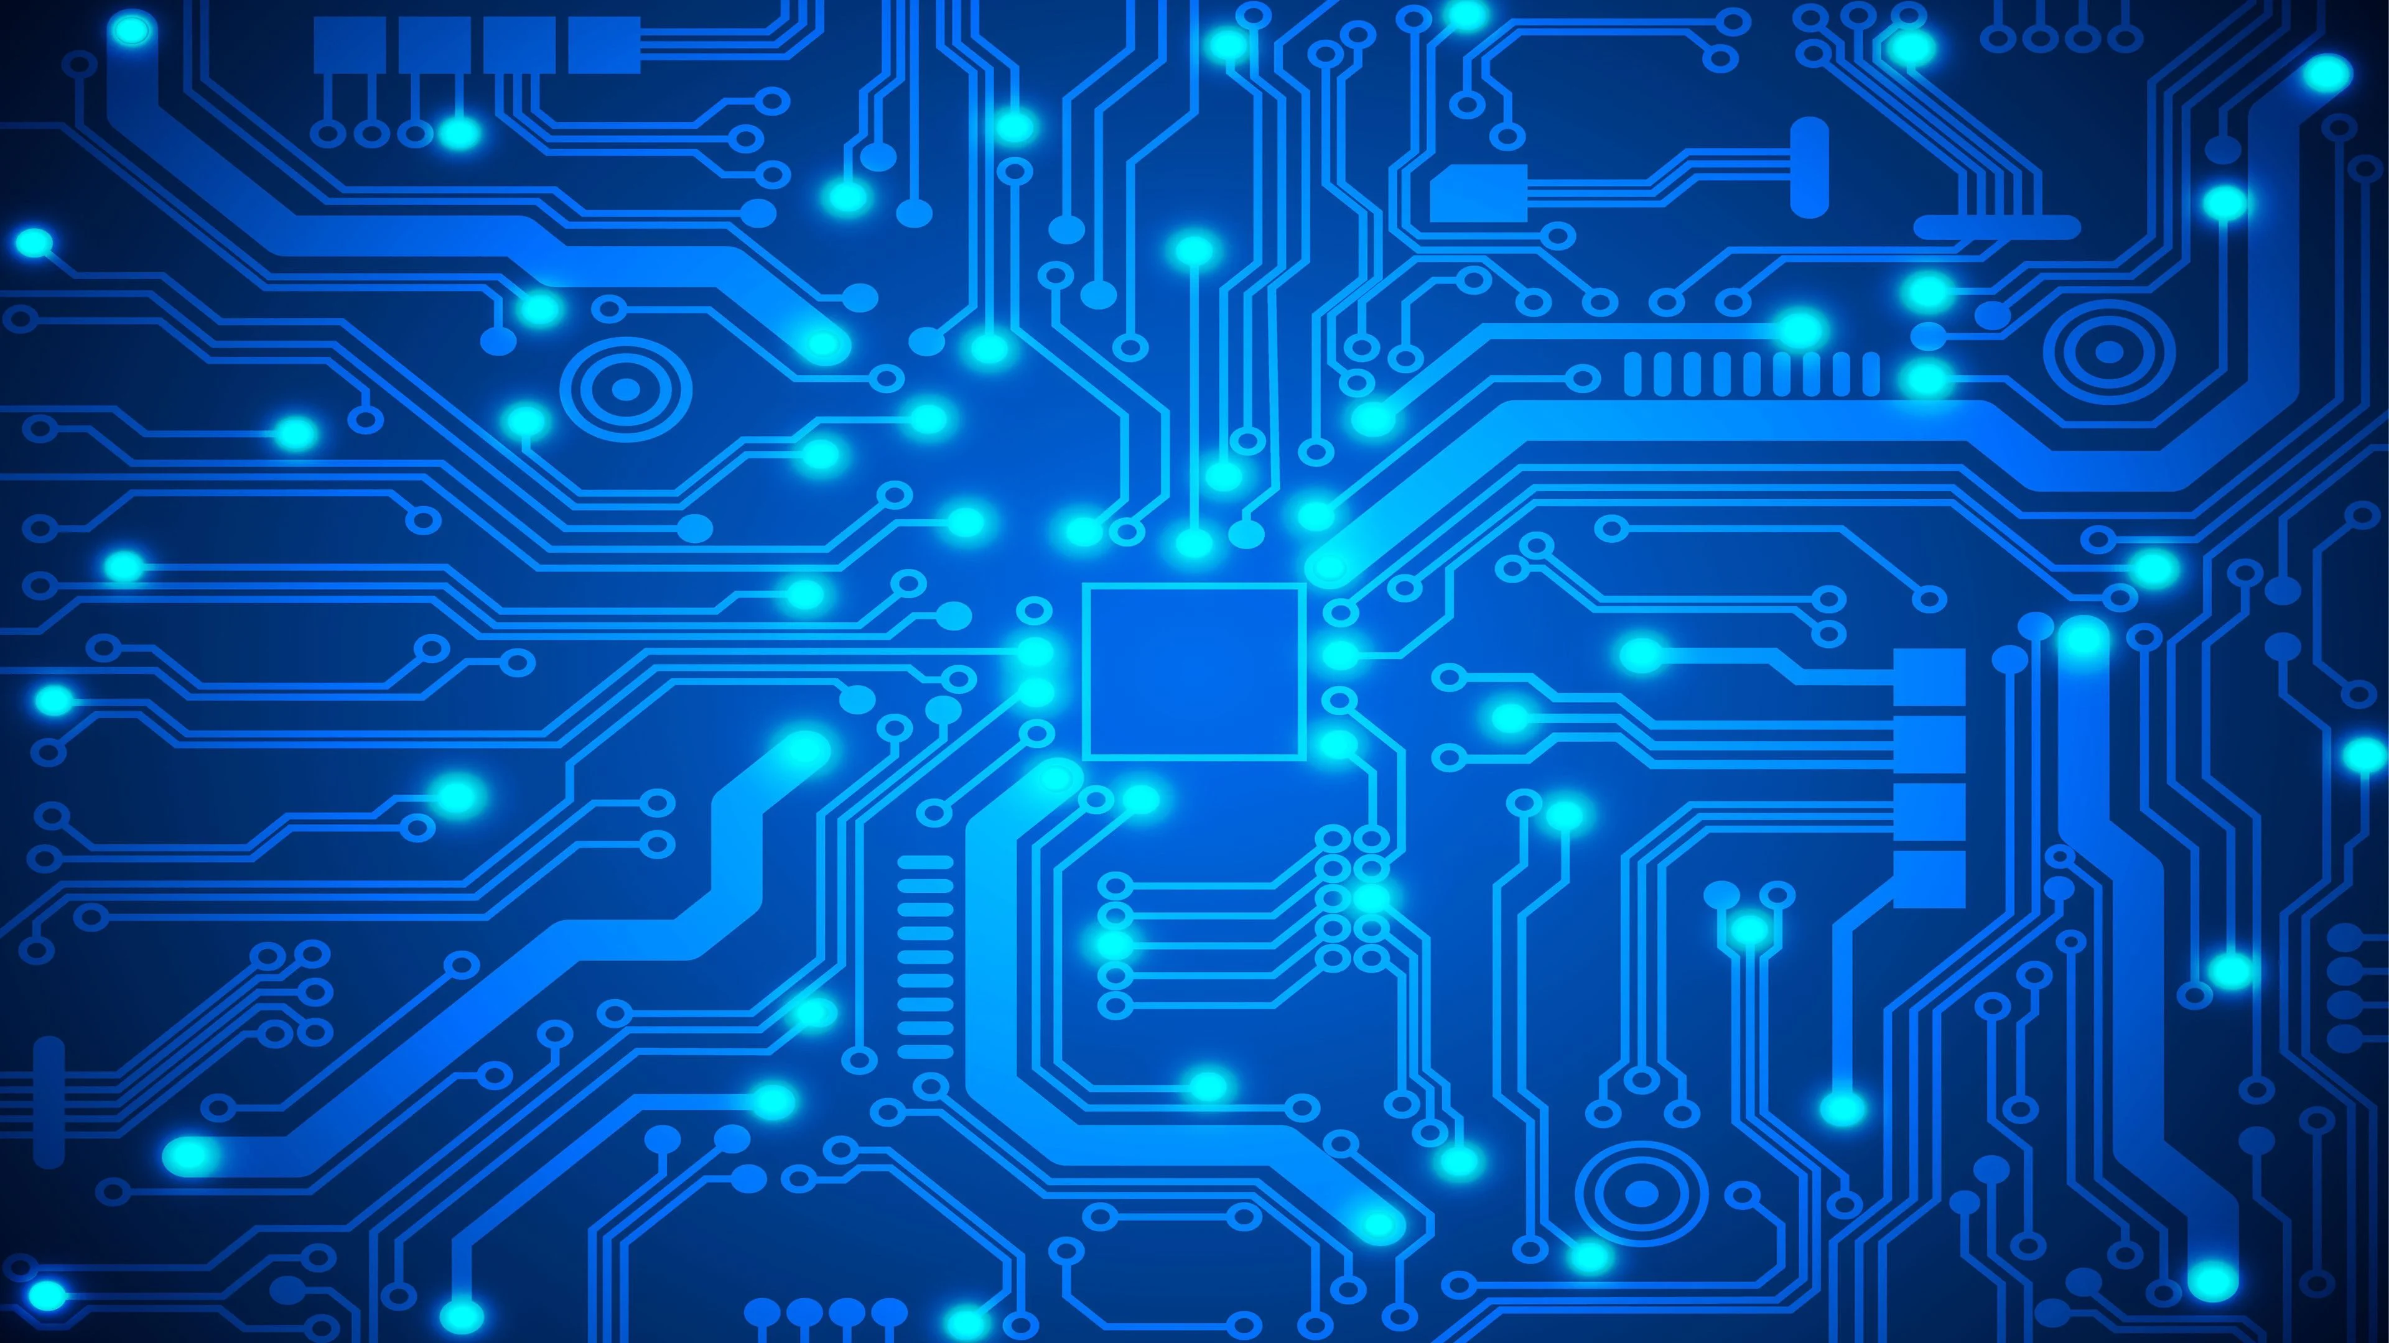

SEICHE 2022 Introduction to Arduino Lesson 7/8– Grounding, ESD, Breadboards, Schematics, Resistors, Connecting LEDs
Instructor: Paul Frommeyer
www.paulfrommeyer.com
Corporate Sponsor: DXC Technology

Slide 2
REMEMBER!
Immediately copy the latest lesson folder (Lesson9 today) from your USB flash drive to your hard drive where you previously copied the other flash drive files (probably Documents folder)

Slide 3
Lesson Plan Overview
Lesson 1 – Intro and Setup
[may require 2 classes]
• Introduction to class format
• Overview of lesson plan
• Presentation format (monitor, camera, screen, whiteboard)
• Inventory of Arduino kits
• Inventory of USB drives
• Installation of ESP32 serial port drivers (Windows only)
• Installation of Arduino software
• History of Computing
Lesson 2 and 3 – Laptop operation review
• Control panel/Settings location
• Home directories and folder hierarchy
• Arduino file locations
• Search functions
• Open questions and issues
• History of Computing redux
Lesson 4 and 5 – IDE essentials
• The boards manager
• Setting board type
• Installing Libraries
• Loading example sketches
• Finding and selecting the Arduino USB port
• Uploading a sketch to the microcontroller [Example Sketch#1]
• Basic Arduino sketch (program) structure
• Uploading your own sketch [Class Sketch #2]
• History of Telecommunications and Networking – Part 1
Lesson 6 – DC Electricity Basics and DMM Intro
• Quick review: DC vs AC electric currents
• DC current operation
• Voltage vs Amperage (current)
• Ohm’s Law
• Series vs parallel circuits
• Introduction to basic DMM functions and usage
• Measuring voltage [DMM usage #1]
• History of Telecommunications and Networking – Part 2
Lesson 7 and 8 – Grounding, ESD, and Connecting LEDs
• Grounding
• The Phantom Menace of ESD
• Resistors!
• LED’s [DMM usage #2, maybe]
• Powering LEDs – Ballast and dropping resistors
• Connecting LEDs to microcontrollers
• Parts of an Arduino Sketch
• ESP32 Specifications – Ampacity
• Let there be Light! – Class Sketch #2
• History of Telecommunications and Networking – Part 3
Lesson 9 – ESP32 External power sources [may require 2 classes]
• Capacitors!
• Microcontroller board power requirements
• Board power input options and grounding
• Components with different voltage requirements – level shifting
• External power circuit design
• Simplified serial communication protocols
• One-wire serial communication protocol
• Hardware vs software serial
• WS2812B and Neopixel connections – Class Sketch #3
• External device power design
Lesson 12 – Connecting LCD and Matrix Displays
• The SPI serial protocol
• SPI connections – Class Sketch #5
• SPI device external power design
Lesson 13 – Connecting sensors [Time permitting]
• Connecting buttons
• Connecting potentiometers and voltage dividers
• Reading buttons and debouncing
• Reading potentiometers
Lesson 14 – Connecting more sensors [Time permitting]
• Connecting I2C sensors and photoresistors
• Using ESP32 integral touch sensors

Slide 4
Lesson 9 – Smart LED Strips
Capacitors!
Board power input options and grounding
External and USB Power
Peripherals with different voltage requirements – level shifting
External power circuit design
WS2812B and Neopixel connections
Class Sketch #3
History of Telecommunications and Networking (Time Permitting)

Slide 5
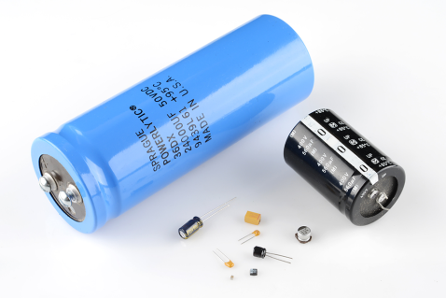
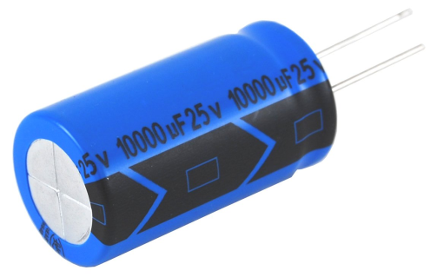
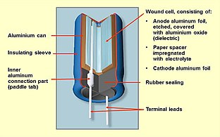
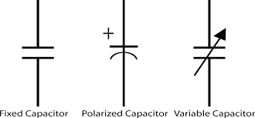
Our Second Component – Capacitors
A capacitor is a two-terminal, electrical component. Along with resistors and inductors, they are one of the most fundamental passive components we use. You would have to look very hard to find a circuit which didn't have a capacitor in it. [Sparkfun]
What makes capacitors special is their ability to store energy; they're like a fully charged electric battery. Caps, as we usually refer to them, have all sorts of critical applications in circuits. Common applications include local energy storage, voltage spike suppression, and complex signal filtering. [Sparkfun]
Capacitors come in two varieties, polarized and non-polarized. Polarized capacitors have specific leads for positive and negative electrical connections.
Most polarized capacitors are electrolytic. An electrolytic capacitor is a polarized capacitor whose anode or positive plate is made of a metal that forms an insulating oxide layer through anodization. Due to their very thin dielectric oxide layer and enlarged anode surface, electrolytic capacitors have a much higher capacitance-voltage (CV) product per unit volume than ceramic capacitors or film capacitors, and so can have large capacitance values. [Wikipedia]
Capacitors are critical components, pervasive in electronic devices

Slide 6
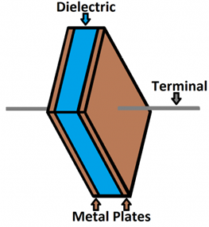
Capacitors - Measurement
Each capacitor is built to have a specific amount of capacitance. The capacitance of a capacitor tells you how much charge it can store, more capacitance means more capacity to store charge. The standard unit of capacitance is called the farad, which is abbreviated F.
It turns out that a farad is a lot of capacitance, even 0.001F (1 milifarad -- 1mF) is a big capacitor. Usually you'll see capacitors rated in the pico- (10-12) to microfarad (10-6) range.
When you get into the farad to kilofarad range of capacitance, you start talking about special caps called super or ultra-capacitors.
[Sparkfun]
Prefix Name | Abbreviation | Weight | Equivalent Farads
Picofarad | pF | 10⁻¹² | 0.000000000001 F
Nanofarad | nF | 10⁻⁹ | 0.000000001 F
Microfarad | µF | 10⁻⁶ | 0.000001 F
Milifarad | mF | 10⁻³ | 0.001 F
Kilofarad | kF | 10³ | 1000 F

Slide 7
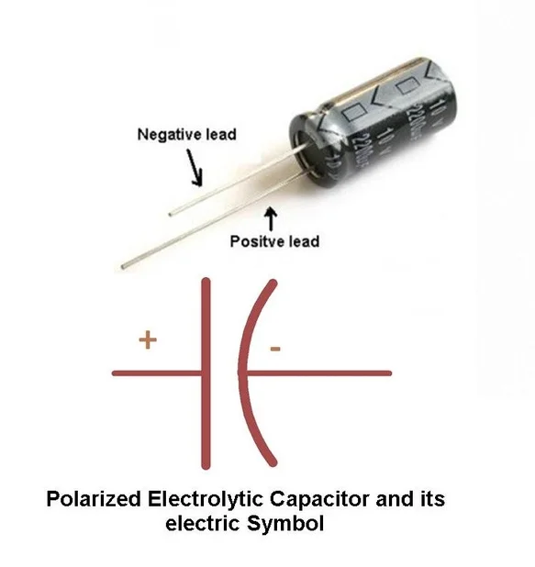
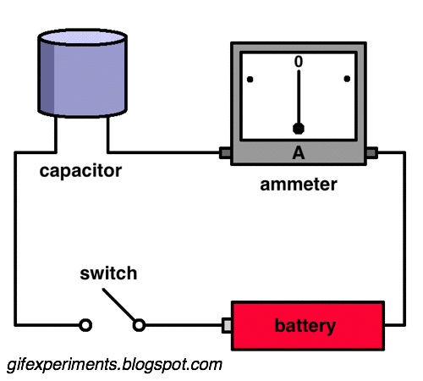
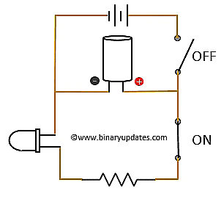
Capacitors - Operation
When positive and negative charges coalesce on the capacitor plates, the capacitor becomes charged. A capacitor can retain its electric field -- hold its charge -- because the positive and negative charges on each of the plates attract each other but never reach each other.
At some point the capacitor plates will be so full of charges that they just can't accept any more. There are enough negative charges on one plate that they can repel any others that try to join. This is where the capacitance (farads) of a capacitor comes into play, which tells you the maximum amount of charge the cap can store.
If a path in the circuit is created, which allows the charges to find another path to each other, they'll leave the capacitor, and it will discharge. [Sparkfun]

Slide 8
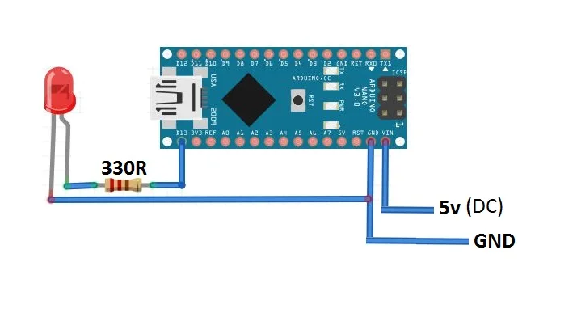
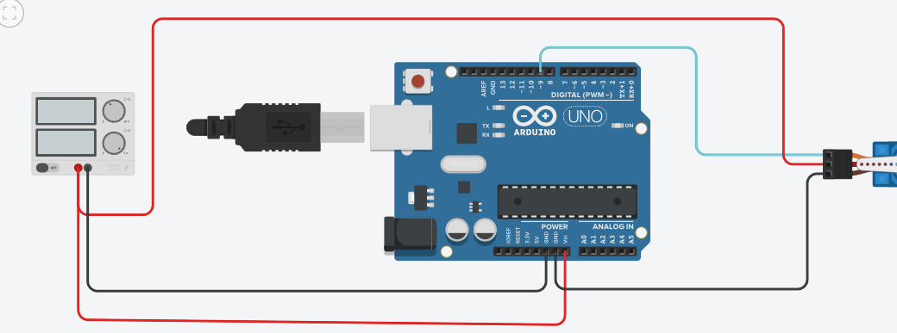
Board Power Input Options And Grounding
All boards can be powered externally, without USB connected.
Some boards, such as the Arduino Uno, have an external power connector right on the board.
For other boards, things can get more complicated
The #1 rule in all cases is that ALL DEVICES MUST SHARE A COMMON GROUND (RAIL).
Failure to provide common ground can, and probably will, cause component damage
It is very dangerous to connect USB power and external power rails together. Damage and even fire can result.

Slide 9
External and USB Power
Connecting USB and external power at the same time will frequently fry a board. This is especially true for the ESP-32, which uses lower capacity power regulation as it uses 3VDC.
The easiest solution is (obviously) to only have one plugged in at a time.
BEWARE!: As previously noted, when on USB power many boards will still supply 4.2VDC from the USB connector to the 5 volt rail. This allows peripherals to operate on USB power.
That’s not a problem for low current devices, but quantities of Neopixels will burn out the regulator, the laptop’s USB chip, or both.
The solution to this problem is to place a diode in-line between the 5 volt rail and the board’s input power pin.
The diode prevents power from “flowing back” from USB power to the peripherals.

Slide 10
Different Voltage Requirements
Not all peripherals will run at the same voltage as the microprocessor board you are using
This results in different signal level tolerances. Not the power rails, but the control signals themselves operate at different voltages.
Transmitting a 5 volt signal into a 3.3 volt device will damage or destroy the receiving device. This is as true for SPI as it is for traditional RS-232C TTL serial connections.
Transmitting a 3 volt signal into a 5 volt device sometimes works. It depends on how well designed the receiving device is.
The best-practice solution to this problem is to use devices called level shifters. Level shifters provide voltage translation between the two different signal levels.

Slide 11
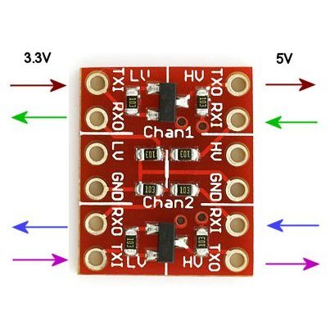
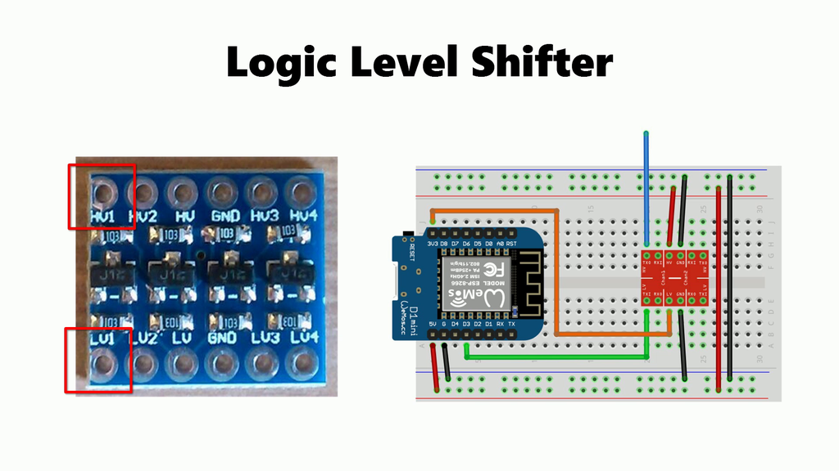
Level Shifters
Level shifters provide bidirectional translation of logical signal voltages between different digital peripherals and devices
For instance, if you needed to connect a 3.3V microcontroller to a 5V real time clock (RTC), you would use a level shifter on the SPI or I2C serial connections
Nearly all level shifters are for 5 VDC and 3.3VDC translation
Level shifters are not self powered; they must have external power connections to the higher voltage (5V) rail

Slide 12
External Power Circuit Design
All microcontroller boards have a range of external input power they will accept
Not all boards have direct USB interfaces
External power should be applied to the board’s external power input pin. This is usually shown on the board pinout
The Heltec Wifi Kit 32 accepts power on the 5V pin
The maximum external power a Heltec will accept is six (6) volts.
Always maintain common grounding between all components, peripherals, and devices!

Slide 13
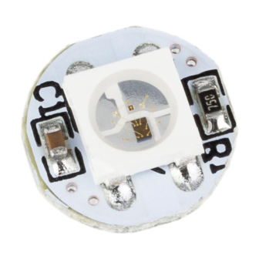
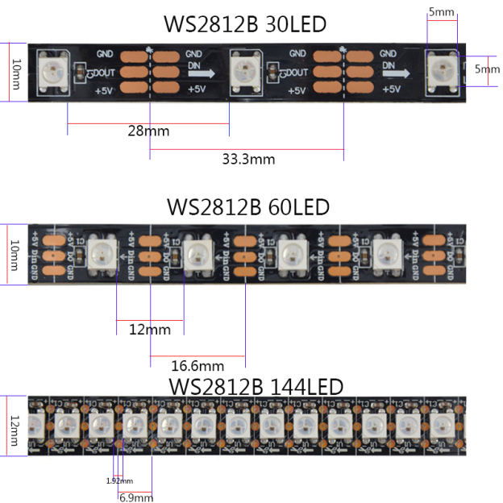
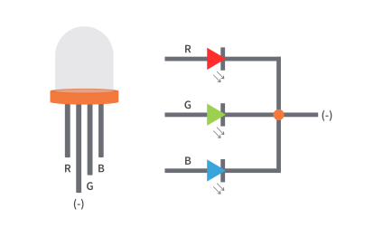
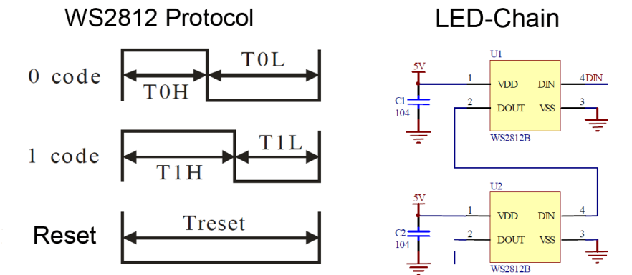
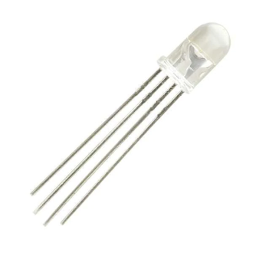
The WS2812B LED aka Neopixel
The WS2812B is an (integrated) chip and 5050 package (flat, square) RGB LED
An RGB LED can display 24 bits of color (0-255 red, 0-255 green, 0-255 blue)
There are RGB LED controllers other than the WS2812B; discussion of those is outside the scope of our class
“Neopixel” is a proprietary marketing term used by Adafruit Industries for their line of products based on the WS2812B
RGB LEDs, and their chipsets, can be designed to run at 5VDC and 12VDC
The chips of “Smart” LEDs make them individually controllable
Control is by means of a one-wire transmit-only serial data protocol; the signal is directional with an input and an output for each pixel. Usually daisy-chained.
This is the WS2812B chip
5050 RGB LED package
“Traditional” RGB LED
(5mm package)
Types of WS2812B Strips
PIXELS ARE DIRECTIONAL!!!

Slide 14
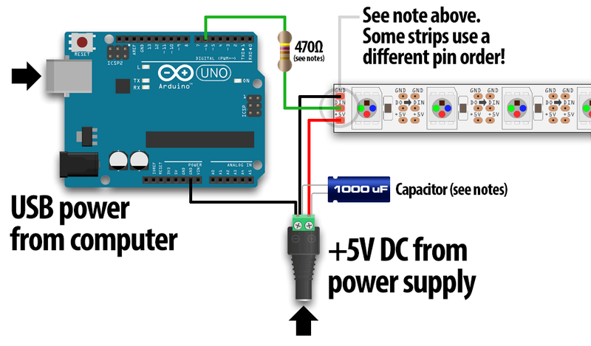
External Power and WS2812B Neopixels
RGB LEDs of any kind draw LOTS of current. 20mA per LED x 3 LEDs = 60 mA of current as a general power budget. THAT’S PER LED.
More than 5 Neopixels will overload most 500mA board power regulators.
The solution to this problem is to use external power for the LED strip.
When the external power is 12 or 5 volts and the microcontroller is 3 volts things get very tricky indeed
It’s OK to send 5V to the board input power pin and the LEDs simultaneously
It’s generally NOT OK to connect USB power at the same time
Level shifting may be required for the serial data line (Data IN) to the Neopixels. This is entirely dependent on the pixel type. YMMV!
The ability to SAFELY connect USB power and external power at the same time depends on the board!!!
Most boards will attempt to power peripheral devices using USB power
There is no sanity checking of this action
Trying to power numbers of Neopixels from any board will overload the onboard regulator

Slide 15
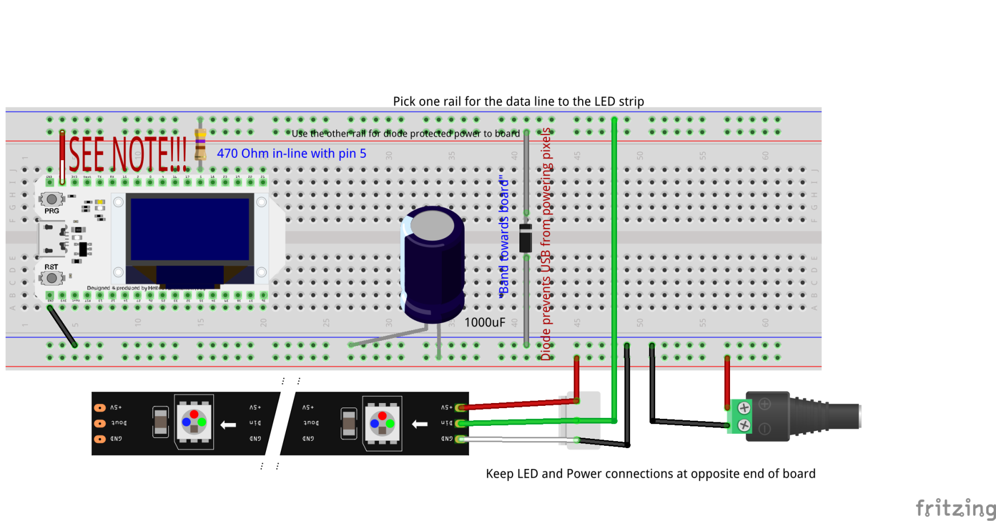
Wiring an ESP32 and Neopixels
From your Arduino kits:
Green power plug adapter
1000uF capacitor
WS2812B LED strip
One (1) general purpose diode
Male-Male DuPont jumpers as required
Wire your breadboard up to look like this:
In spite of extensive pre-testing of the design, it turns out that our LED strips are an off-brand that will probably not operate without level shifters. These will be supplied in the next class.
NEVER connect USB and external power without the in-line diode. Something will go terribly wrong otherwise.
The 1000uF capacitors are loose in the large plastic boxes in your kits
These are DuPont Male-Male jumper wires that connect directly from the breadboard rails to the mail LED strip connector and power plug.
Be 100% certain that you have not reversed the 5V and ground connections to the LED strip!
Ground wire on strips is WHITE, not BLACK.
Have your instructor check all work before applying power to anything!

Slide 16
The FastLED Library
Find the Arduino sketch in your Lesson 9 folder (which you copied from your USB drives, right?) named “ClassSketch3-V2” and open it in the Arduino IDE (double clicking the [.ino] file is easiest)
Open the Library manager (Tools-Manage Libraries)
Search for the FastLED Library
Install the latest version
Close the Library manager when done
Search for FastLED
Install it
This one!

Slide 17
Let There Be Light Redux
Leave the IDE open and your ClassSketch3-V2 open
Connect your board to your laptop using USB cable (board end first, then the laptop end!) LEAVE EXTERNAL 5V POWER DISCONNECTED!!!
Remember to set your board type and port speed! (Change speed if initial upload fails!)
Upload the sketch! ➔ (this also validates it first)
Disconnect USB!!!
Connect the external 5VDC power supply
Did it work? Enjoy the light show!☺
It didn’t work? Now we get to troubleshoot!🔧😎
See what happens if you change “RAINBOW true” to “RAINBOW false” in your sketch. Remember to reupload after modifications!

Slide 18
Anatomy of a sketch
#include <FastLED.h>
// How many leds in your strip?
#define NUM_LEDS 30
// Which pin is the pixel DIN line connected to?
#define DATA_PIN 5
#define LED_TYPE WS2812B
#define COLOR_ORDER GRB
#define BRIGHTNESS 30
#define RAINBOW true
Setup()
{
delay(3000);
FastLED.addLeds<LED_TYPE, DATA_PIN, COLOR_ORDER>(leds, NUM_LEDS); FastLED.setBrightness(BRIGHTNESS);
}
void loop()
{
if (RAINBOW)
{
fill_rainbow(leds,NUM_LEDS,i++,1);
FastLED.show();
}
…
These are actually macro definitions, and not variable declaration. Macros are substituted wherever they appear. More on that next semester.
Setup section excerpt
What happens if you change the RAINBOW def to false?

Slide 19
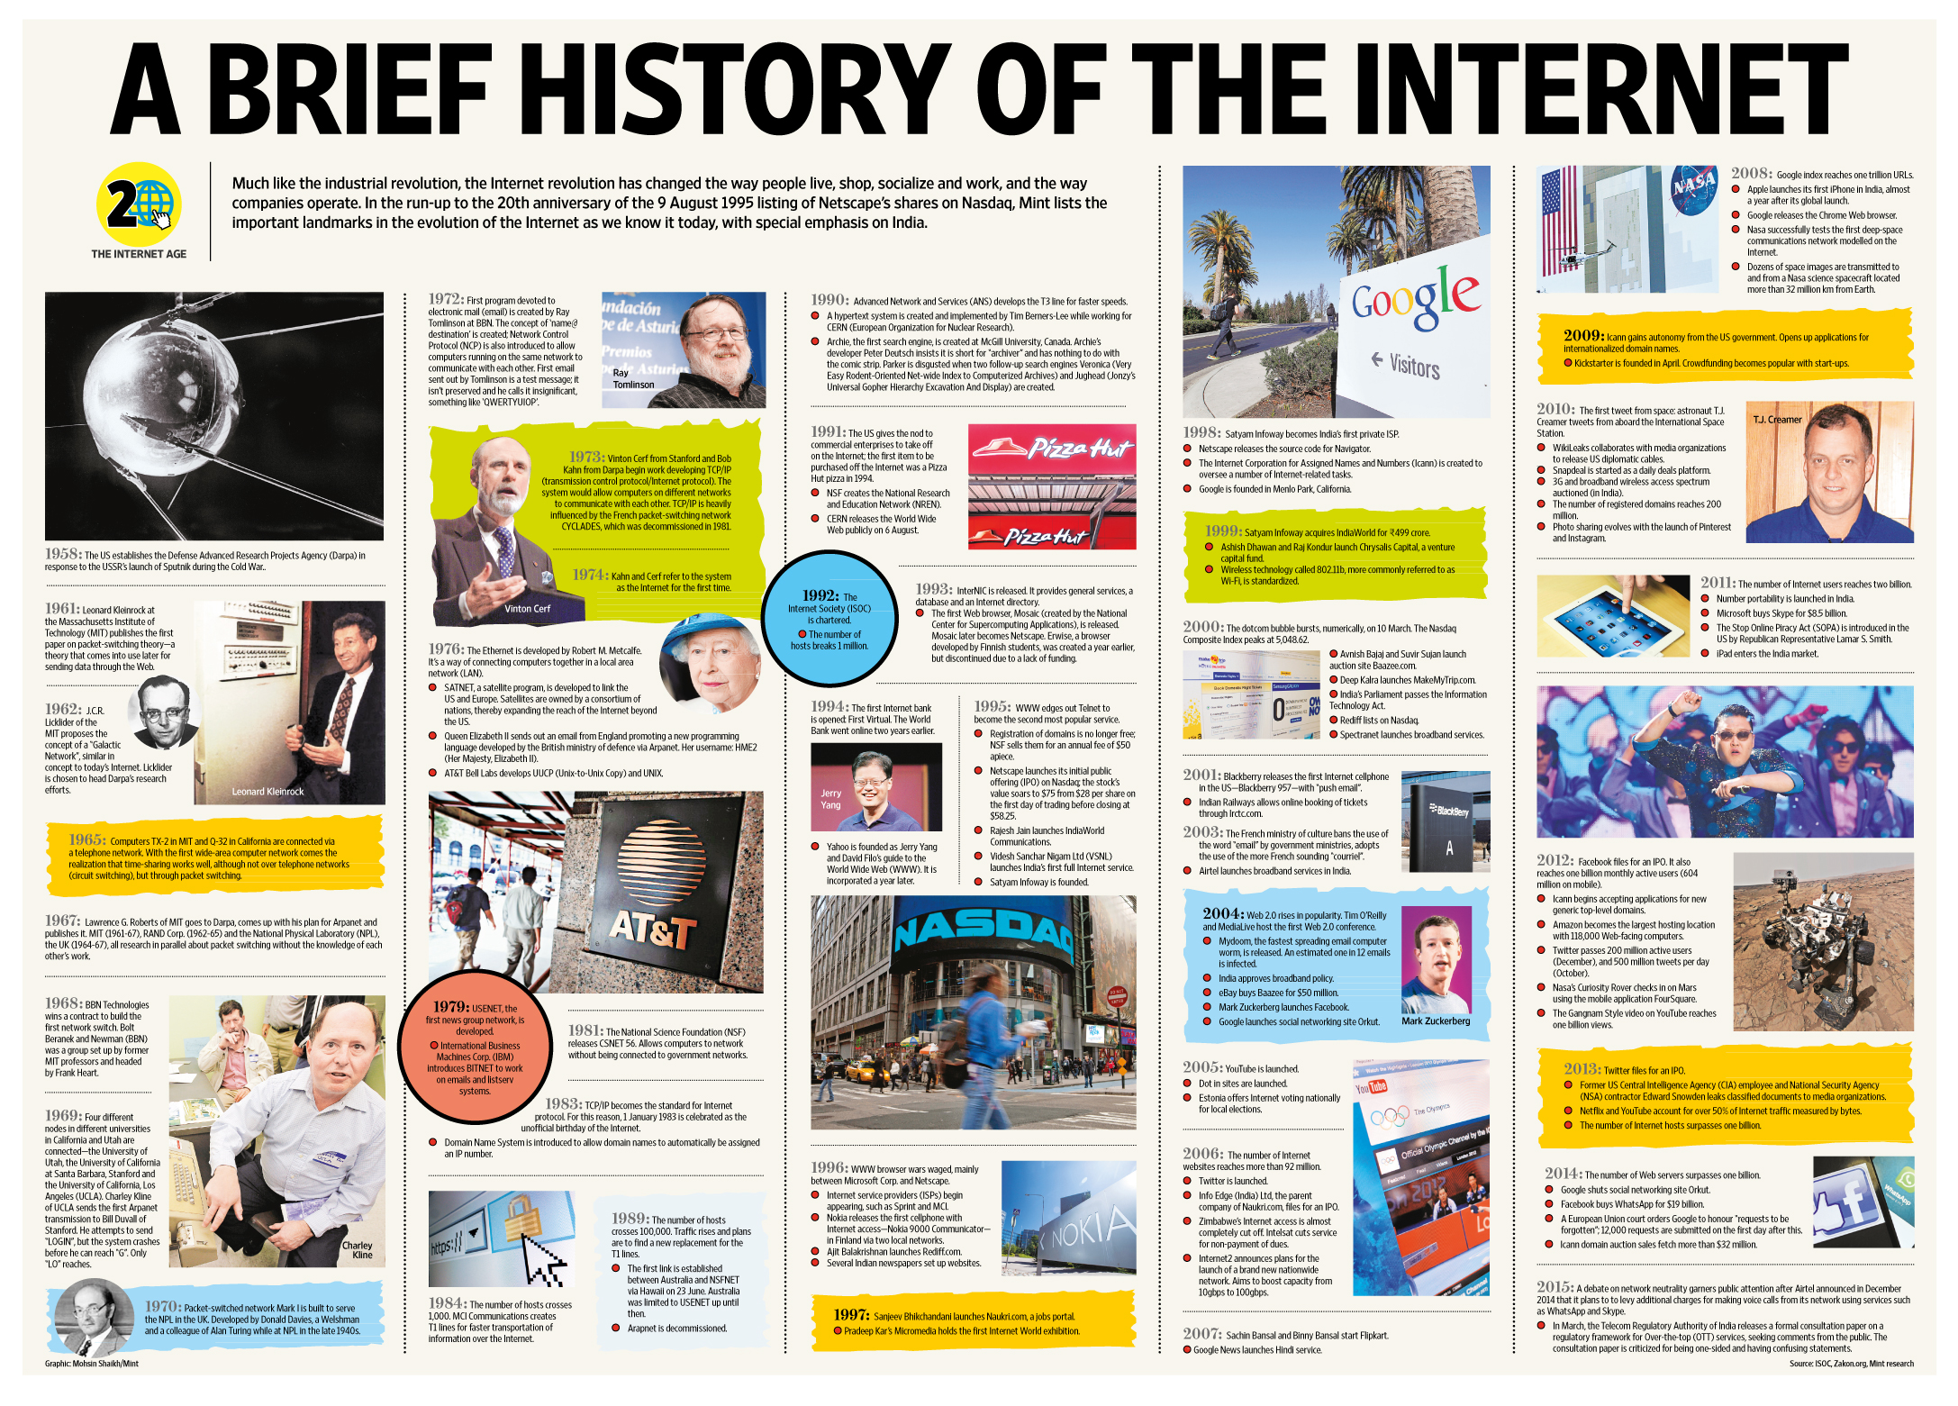
History of Telecommunications Part 2
Local Area Networks (LANs)
Wide Area Networks (WANs)
Wireless LAN (WiFi)
Cellular Voice Networks
Cellular data networks
The Internet - Overview

Slide 20
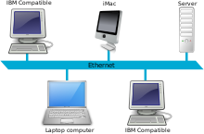
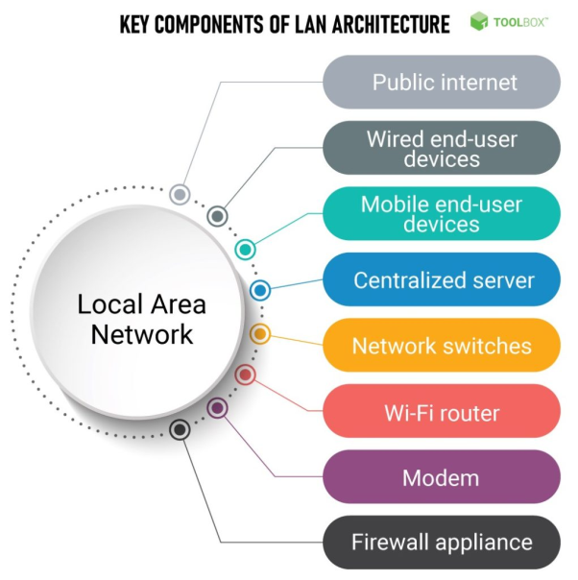
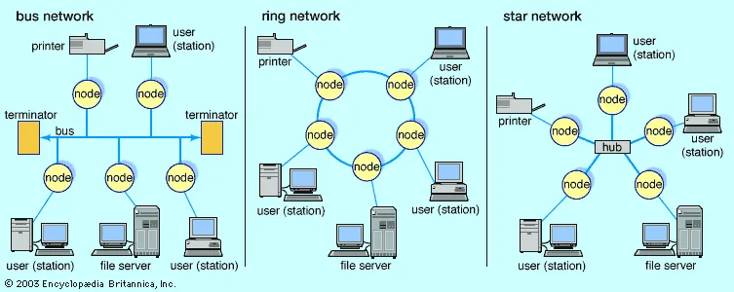
Local Area Networks
A local area network (LAN) is a group of computers and peripheral devices that share a common communications line or wireless link to a server within a distinct geographic area. A local area network may serve as few as two or three users in a home office or thousands of users in a corporation's central office. Source: TechTarget
Regardless of size, a LAN's single defining characteristic is that it connects devices that are in a single, limited area. Source: Cisco Systems
TL;DR a LAN is a group of computers in a single physical location connected together with physical cabling to allow exchange of data

Slide 21
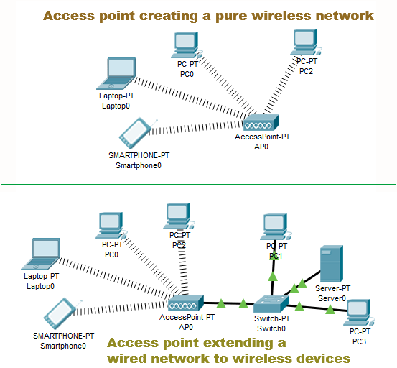
Wireless LAN (WiFi)
WLAN/Wi-Fi is a family of wireless network protocols, based on the IEEE 802.11 family of standards, which are commonly used for local area networking of devices and Internet access, allowing nearby digital devices to exchange data by radio waves. These are the most widely used computer networks in the world, used globally in home and small office networks to link desktop and laptop computers, tablet computers, smartphones, smart TVs, printers, and smart speakers together and to a wireless router to connect them to the Internet, and in wireless access points in public places like coffee shops, hotels, libraries and airports to provide the public Internet access for mobile devices. Source: Wikipedia
WLAN is the wireless technology used to connect computers, tablets, smartphones and other devices to the internet. Wi-Fi is the radio signal sent from a wireless router to a nearby device, which translates the signal into data you can see and use. Source: Verizon

Slide 22
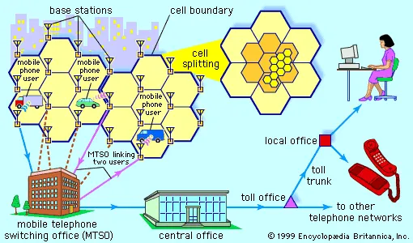
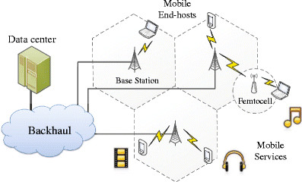
Cellular Voice Networks
A cellular network or mobile network is a communication network where the link to and from end nodes is wireless. The network is distributed over land areas called "cells", each served by at least one fixed-location transceiver (typically three cell sites or base transceiver stations). These base stations provide the cell with the network coverage which can be used for transmission of voice, data, and other types of content. A cell typically uses a different set of frequencies from neighboring cells, to avoid interference and provide guaranteed service quality within each cell. When joined together, these cells provide radio coverage over a wide geographic area. Source: Wikipedia
Cellular networks can be designed to carry voice, data, or both. The earliest cellular networks were voice networks, connecting back to the PSTN (Public Switched Telephone Network).

Slide 23
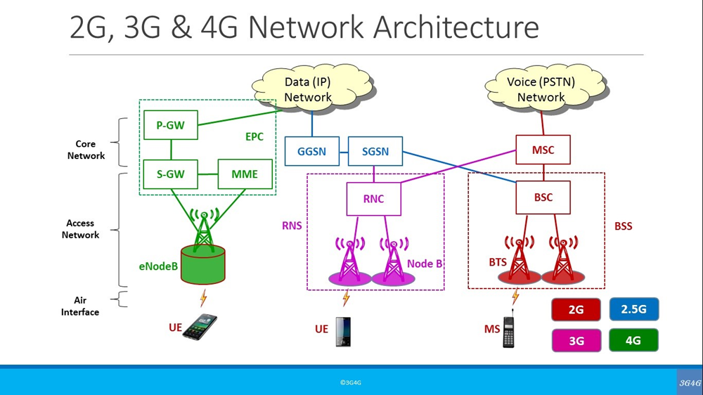
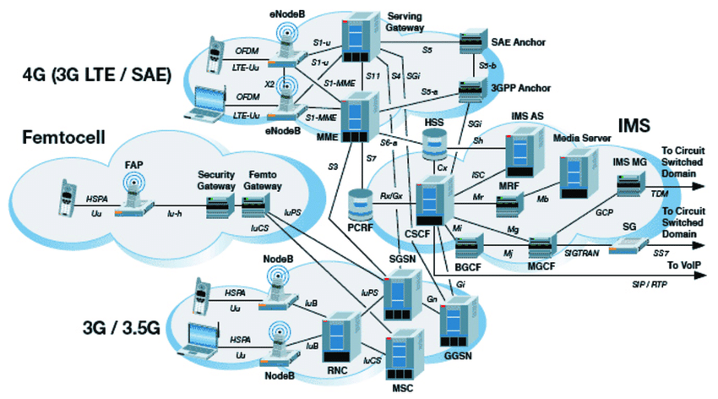
Cellular Data Networks
Cellular Network Data is a data connection from the cellular device to the cell site. LTE (4G), 3G and 1X are types of cellular network data connections. Data sessions include, but are not limited to, browsing the Internet such as Google, streaming music, videos and movies, sending and receiving emails, sending and receiving MMS messages, hotspot hosting and application use. While connected to the cellular data network, data usage will pull from the current data plan.
As with all communications between two computers, “data” refers to information encoded into a bitstream of binary numbers. The method used for encoding varies by network layer, device, and communications protocol.

Slide 24
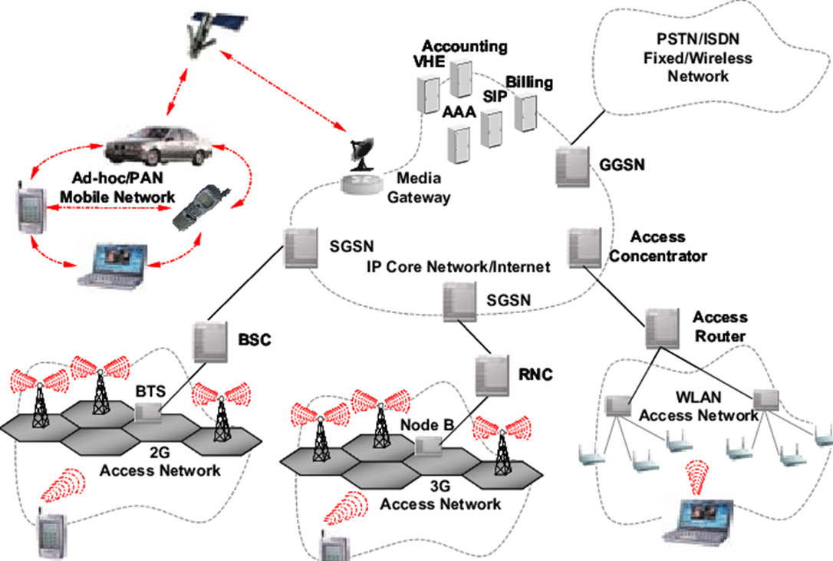
WiFi and Cellular
WiFi connects to a local router, cellular data connects to a remote router
WiFi has a limited range, cellular data does not

Slide 25
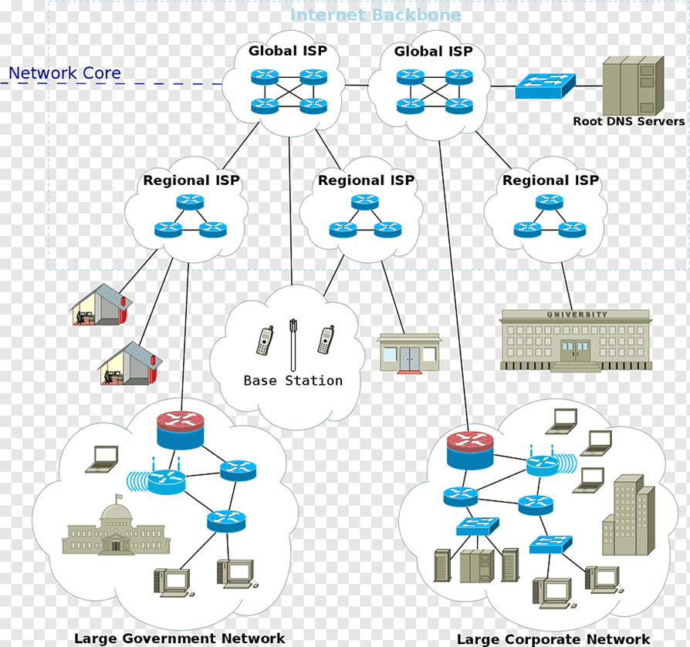
The Internet - Architecture
The Internet is a “network of networks” used to connect many many LANs and WANs together
Originally the Internet was owned and operated by the US DoD and NSF
Public connectivity became available in 1992 from a company called PSI

Slide 26
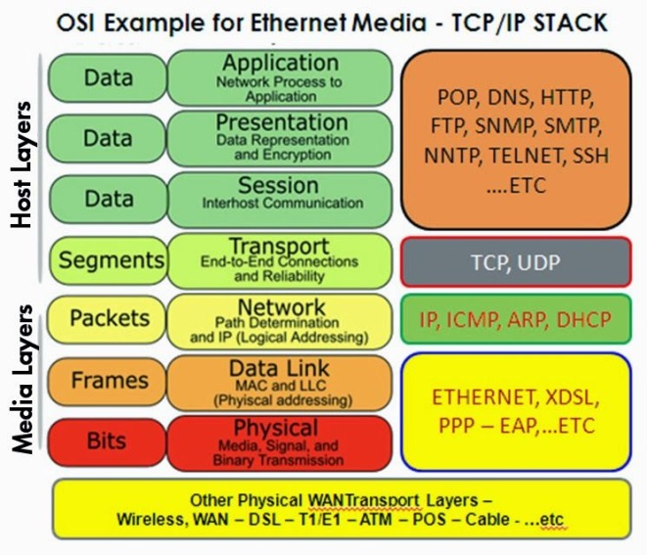
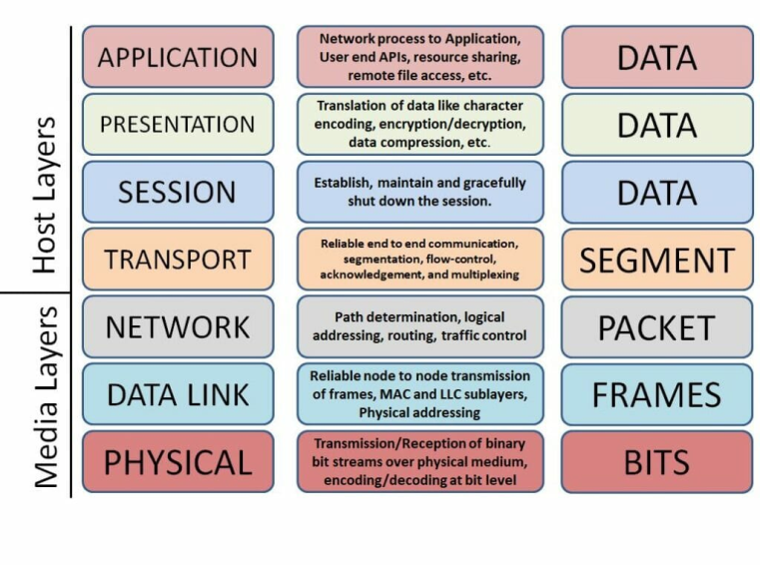
The OSI/ISO Layered Network Model
In a Quora post asking about the purpose of the OSI model, Vikram Kumar answered this way:
“The purpose of the OSI reference model is to guide vendors and developers so the digital communication products and software programs they create will interoperate, and to facilitate clear comparisons among communications tools.”
While some people may argue that the OSI model is obsolete (due to its conceptual nature) and less important than the four layers of the TCP/IP model, Kumar says that “it is difficult to read about networking technology today without seeing references to the OSI model and its layers, because the model’s structure helps to frame discussions of protocols and contrast various technologies.”
If you can understand the OSI model and its layers, you can also then understand which protocols and devices can interoperate with each other when new technologies are developed and explained.
Source: Network World

Slide 27
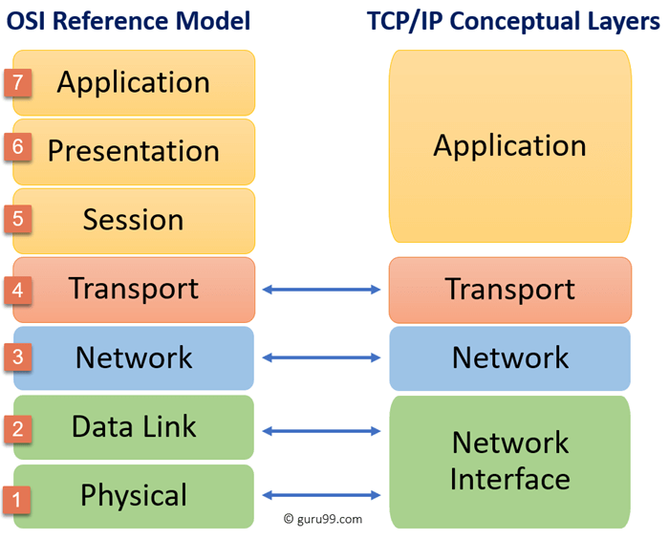
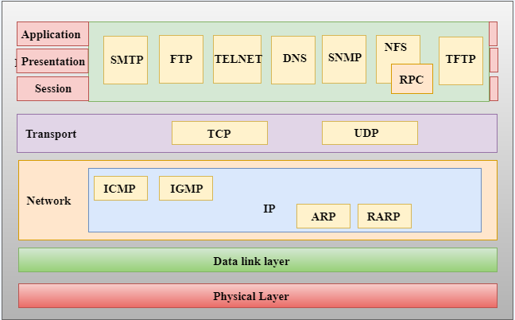
ISO/OSI vs The TCP/IP Model
TCP/IP is the data interchange protocol used by the Internet for computer-to-computer (host-to-host) communications
It only loosely follows the formal OSI/ISO reference model
Many consider TCP/IP to be a separate model, but this is not entirely true
We will not be studying TCP/IP in depth, but it is important to know that it exists and is the underlying protocol used in all web comms
Accurate
Inaccurate

Slide 28
Formal End of Lesson 7
In next week’s exciting episode
Microcontroller board power requirements
Board power input options and grounding
Components with different voltage requirements – level shifting
External power circuit design
Connecting and using transistors
Pulse width modulation and signal generation
Connecting and using buzzers – Class Sketch #3
Don’t forget to return your USB drives!

